Slide 1
Lecture 4
Note: Some slides and/or pictures are adapted from Lecture slides / Books of
Dr Zafar Alvi.
Text Book - Aritificial Intelligence Illuminated by Ben Coppin, Narosa Publishers.
Ref Books
Artificial Intelligence- Structures & Strategies for Complex Problem Solving by George F. Luger, 4th edition, Pearson Education.
Artificial Intelligence A Modern Approach by Stuart Russell & Peter Norvig.
Artificial Intelligence, Third Edition by Patrick Henry Winston

Slide 2
Informed vs Uninformed Methods
A search method is informed if it uses additional information about nodes that have not yet been explored to decide which nodes to examine next.
If a method is not informed, it is uninformed, or blind.
In other words, search methods that use heuristics are informed, and those that do not are blind.

Slide 3
Heuristic
A heuristic evaluation function is a function that when applied to a node gives a value that represents a good estimate of the distance of the node from the goal.
For two nodes m and n, and a heuristic function f, if f(m) < f(n), then it should be the case that m is more likely to be on an optimal path to the goal node than n.
In other words, the lower the heuristic value of a node, the more likely it is that it is on an optimal path to a goal and the more sensible it is for a search method to examine that node.

Slide 4
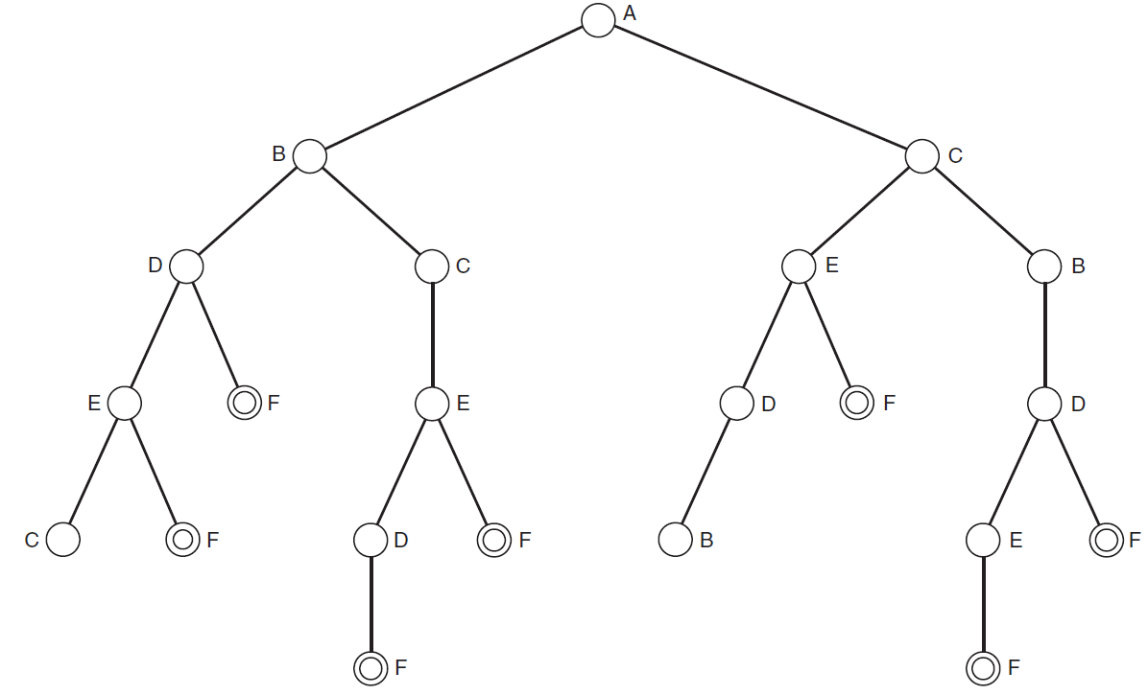

Slide 5
Distance Details
Cities | Distance from F
A | 25
B | 8
C | 20
D | 6
E | 12
F | 0

Slide 6
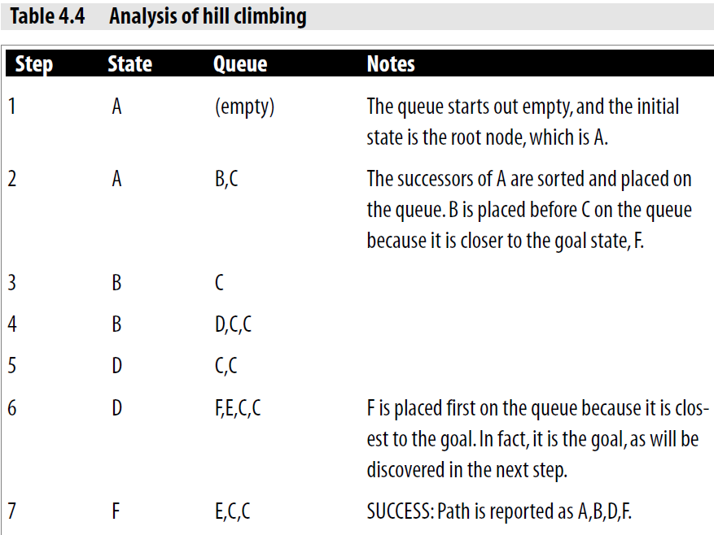

Slide 7
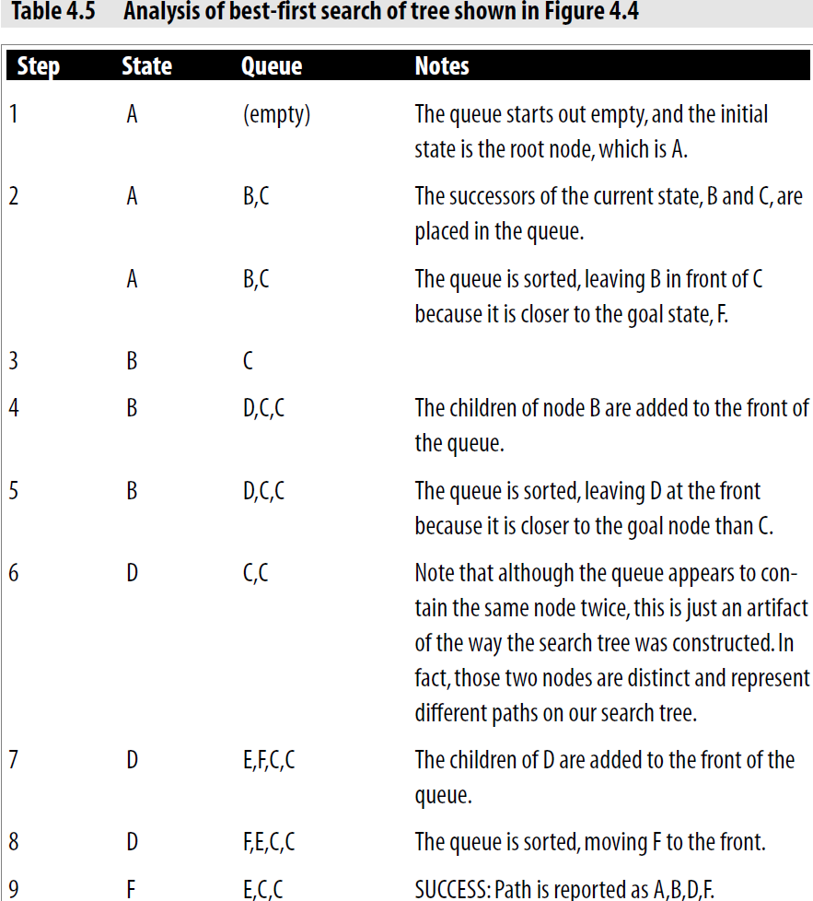

Slide 8
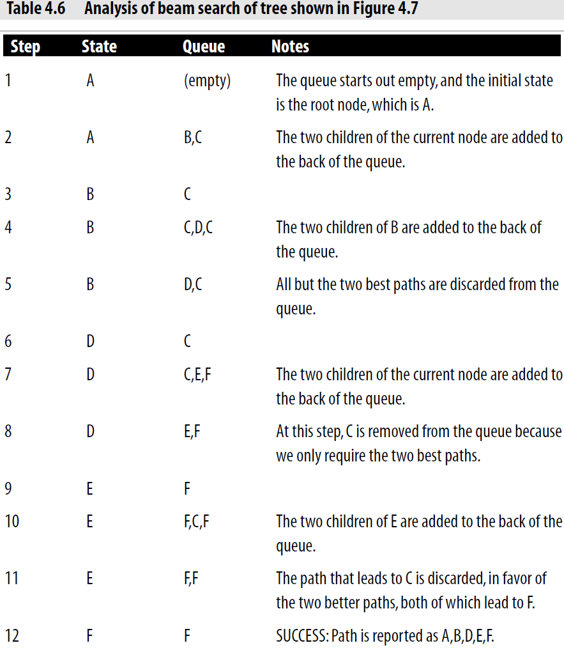

Slide 9
The Knapsack (Fractional) Problem
A man is packing items into his knapsack.
He wants to take the most valuable items he can, but there is a limit on how much weight he can fit in his knapsack.
Each item has a weight wi and is worth vi.
He can only fit a total weight of Wi in his knapsack.
The items that he wants to take are things that can be broken up and still retain their value (like flour or milk), and he is able to take fractions of items.
Hence, the problem is called the fractional knapsack problem.
In solving this problem, a greedy-search algorithm provides the best solution.

Slide 10
The Knapsack(0-1) Problem
The 0-1 knapsack problem is the same as the fractional knapsack problem, except that he cannot take parts of items.
Each item is thus something like a television set or a laptop computer, which must be taken whole.
In solving this problem, a greedy-search approach does not work.

Slide 11
Example
One man has a knapsack that lets him carry a total of 100 pounds. His items are:
1 gold brick worth $1800 and weighing 50 pounds
1 platinum brick worth $1500 and weighing 30 pounds
1 laptop computer worth $2000 and weighing 50 pounds
Hence, we have three items, whose values of v and w are as follows:
v1 = 1800 w1 = 50 v1/w1 = 36
v2 = 1500 w2 = 30 v2/w2 = 50
v3 = 2000 w3 = 50 v3/w3 = 40
In this case, a greedy-search strategy would pick item 2 first, and then would take item 3, giving a total weight of 80 pounds, and a total value of $3500.
In fact, the best solution is to take items 1 and 3 and to leave item 2 behind giving a total weight of 100 pounds and a total value of $3800.

